Slide 1
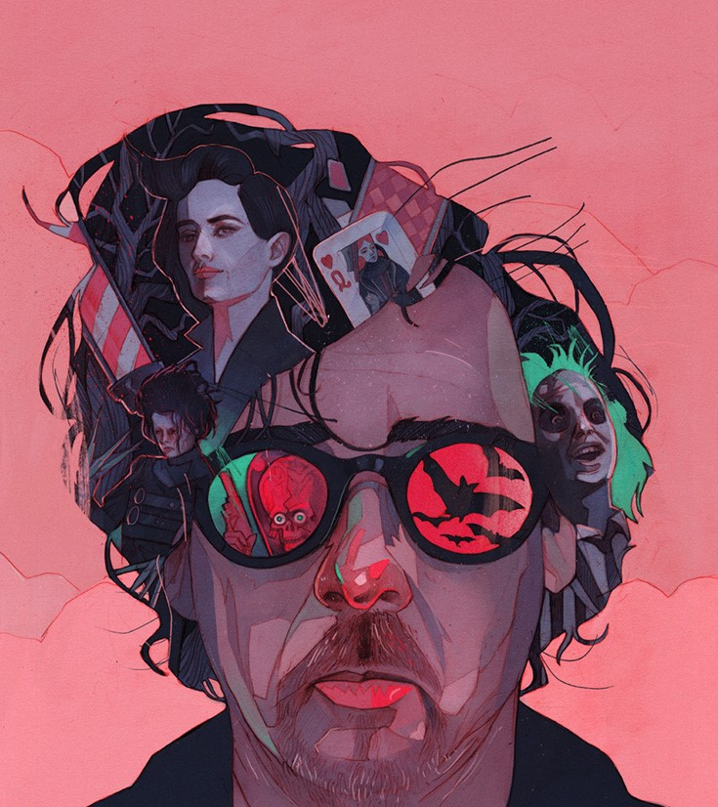
Wins Emmy Award
First child is born
1990
2003
Pee Wee's Big Adventure
Alice in Wonderland
1985
2010
Timothy Walter Burton is born
The Nightmare Before Christmas
Frankenweenie (remake)
Aug 25, 1958
1993
2012
Starts apprenticeship for Walt Disney studios
Batman
Sleepy Hollow
Sweeney Todd
His 60th anniversary
1977
1989
1999
2007
Aug 25, 2018
1958
1958
1965
1972
1979
1986
1993
2000
2007
2014
2020
1988
1994
2015
Today
Beetlejuice
Ed Wood
Gets insignia of Chevalier of Arts and Letters
1984
1992
2009
Frankenweenie
Batman Returns
Producers Guild of America Award for Best Producer
1976
1990
2005
Enrols at the California Institute of the Arts
Edward Scissorhands
Corpse Bride
2002
Starts relationship with H. Bonham Carter
Life events
Movies (directed or produced)

