Slide 1
How to update this template in seconds
The Office Timeline add-in for PowerPoint will help you edit it with just a few clicks.
Get your free 14-day trial of Office Timeline here: https://www.officetimeline.com/14-days-trial Re-open this template, and create your impressive PowerPoint visual in 3 easy steps:
1
Click the Edit Data button on the Office Timeline tab.
2
Use the Data and Timeline views to edit swimlanes, milestones and tasks.
3
Click Save to instantly update the template.

Slide 2
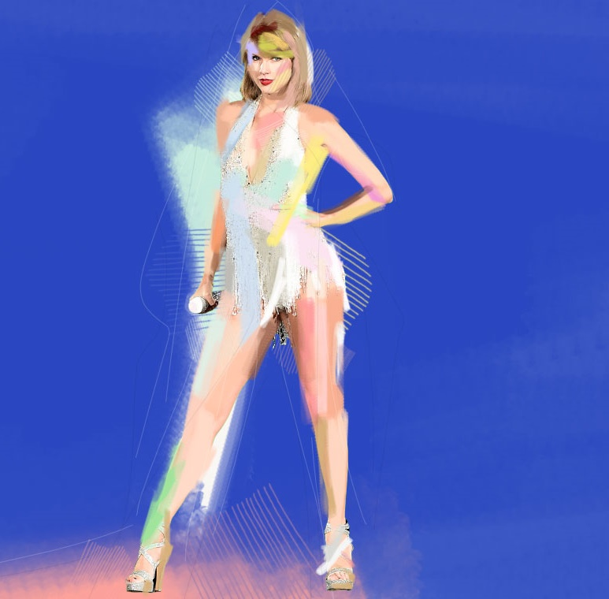
Taylor Swift timeline
TIMELINE
The Eras tour
1st tour as headliner
2023
2009
Taylor Alison Swift is born
Learns to play guitar
Fastest selling single in digital history
Re-recording of her early albums begins
Billionaire status
Dec 13, 1989
2001
Releases 1st single
2012
2020
2006
2023
1989
1992
1995
1998
2001
2004
2007
2010
2013
2016
2019
2022
“Taylor Swift”
“1989”
“Lover”
“Midnights”
2006
2014
2019
2022
“Fearless”
“Red”
“Reputation”
“Folklore”
Albums
2008
2012
2017
2020
“Speak Now”
“Evermore”
2010
2020
Best New Artist Horizon Award
ACM Award - Album of the Year (“Fearless”)
Grammy - Album of the Year (“Midnights”)
2007
2009
2024
VMA Award - Best Female Video
Grammy - Album of the Year (“Folklore”)
2009
2020
Awards
Grammy - Album of the Year (“1989”)
4 Grammys, including for Album of the Year
9 MTV Video Music Awards
2010
2014
2023
Entertainer of the Year CMA Award
2011

